Slide 1
Auction DataSet
File created on: 4/9/22 6:15:43 PM EDT

Slide 2
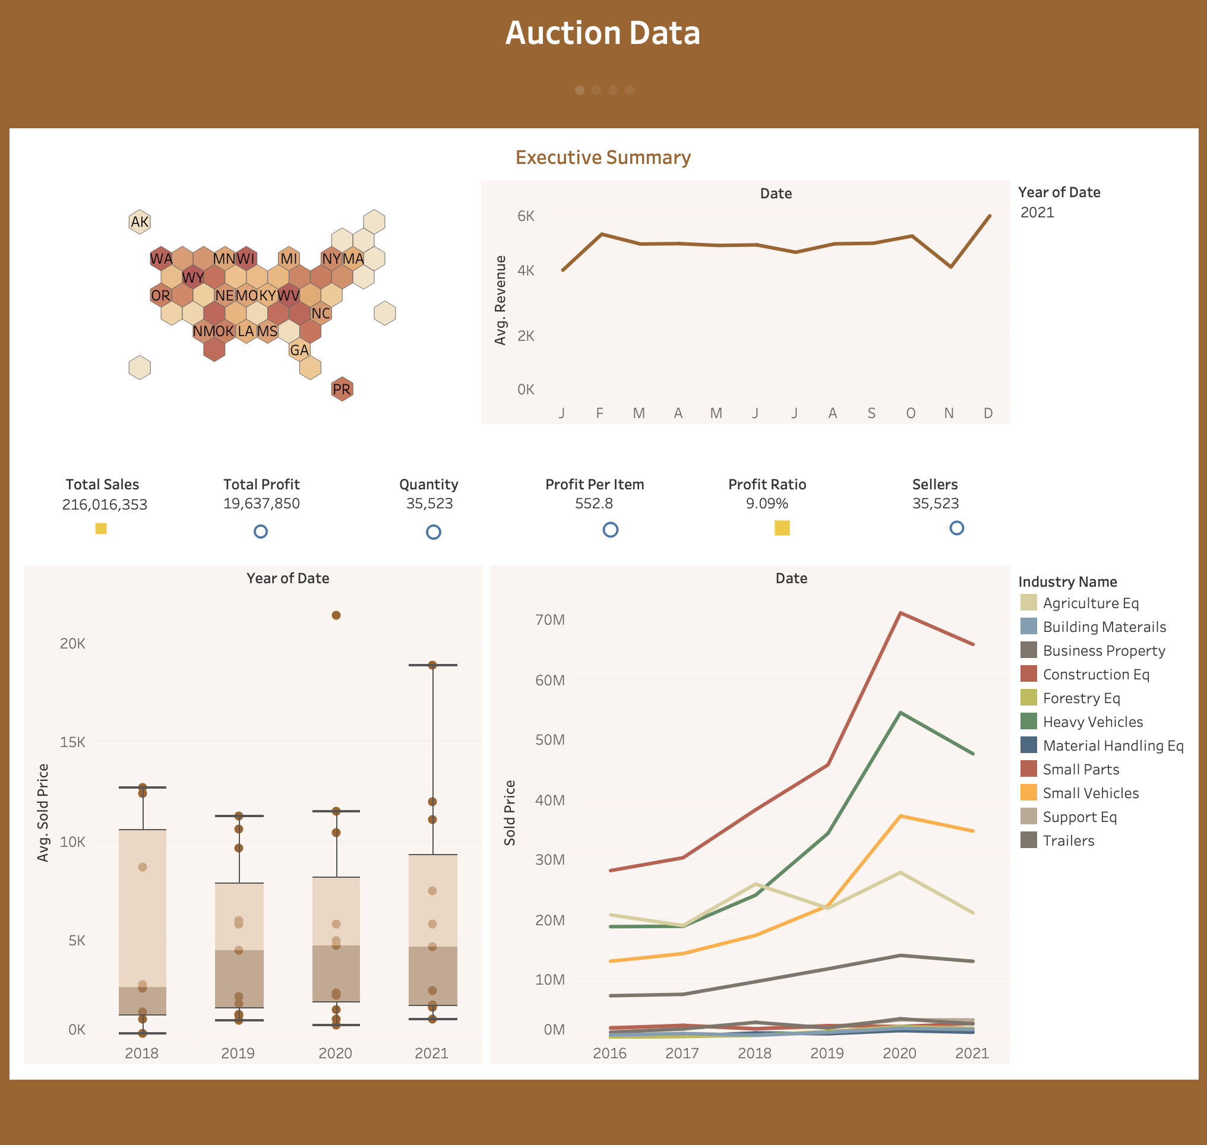

Slide 3
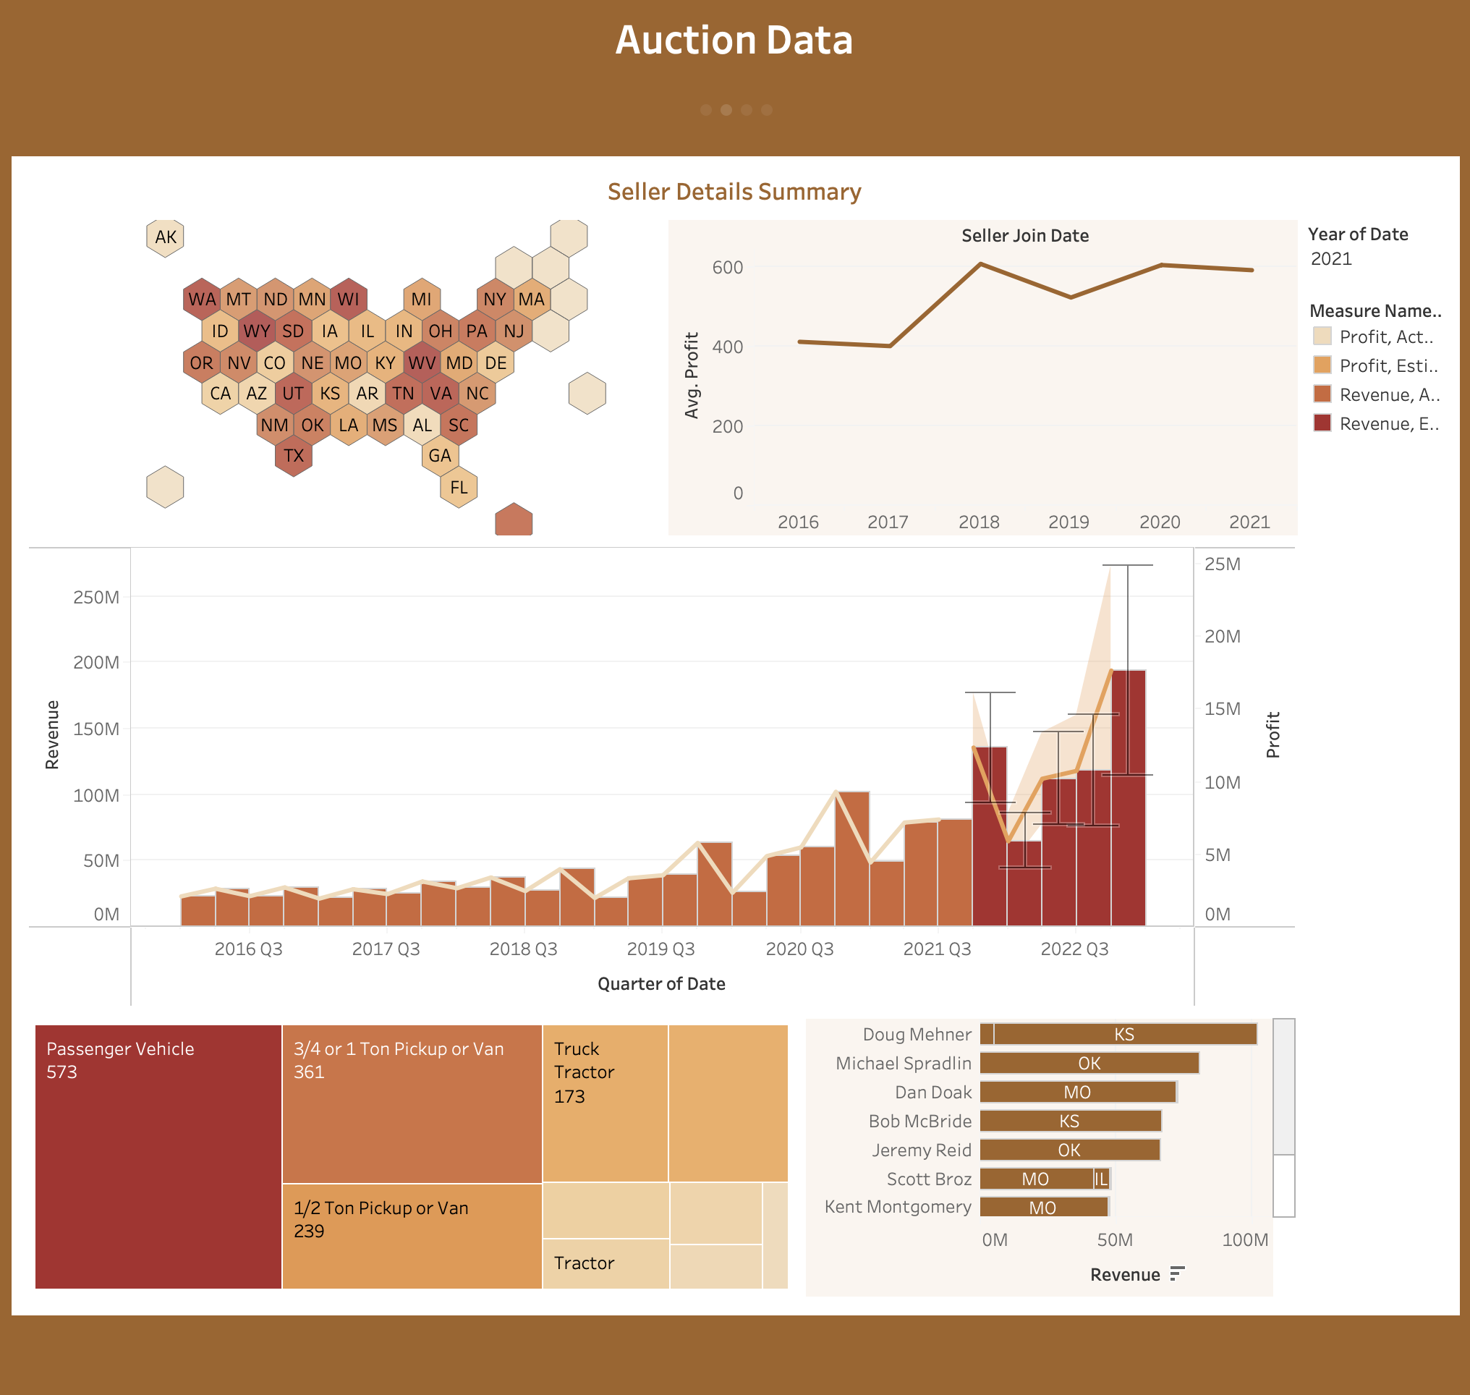

Slide 4
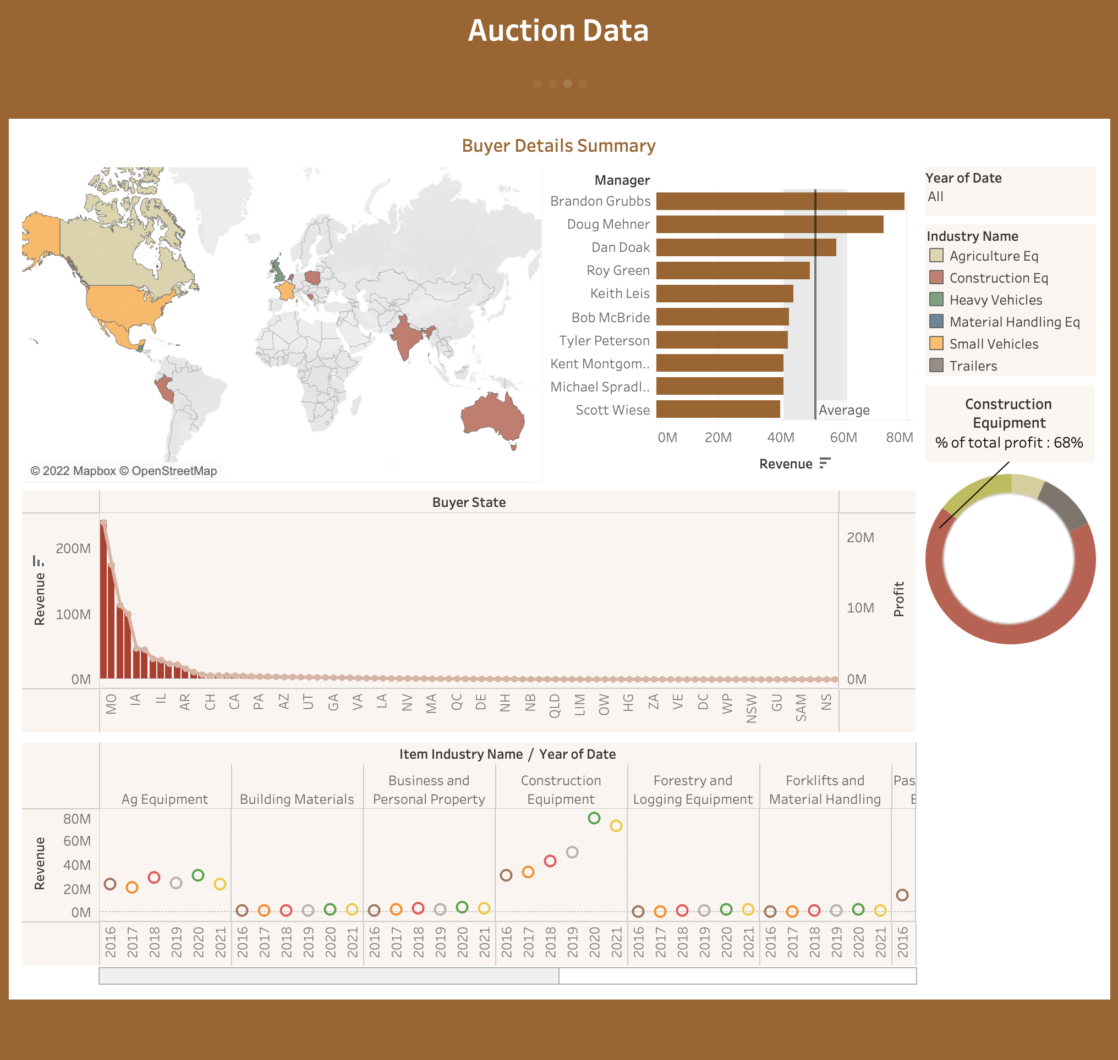

Slide 5
